Slide 1

NOVEMBER 7-9, 2019
Xiaoyue Ma
Research Biostatistician II
Weill Cornell Medicine
Division of Biostatistics and Epidemiology, Department of Healthcare Policy & Research 402 E. 67th Street / C2 – LA0001B, New York, NY 10065
T: (646) 962-8029
xim2008@med.cornell.edu

Slide 2
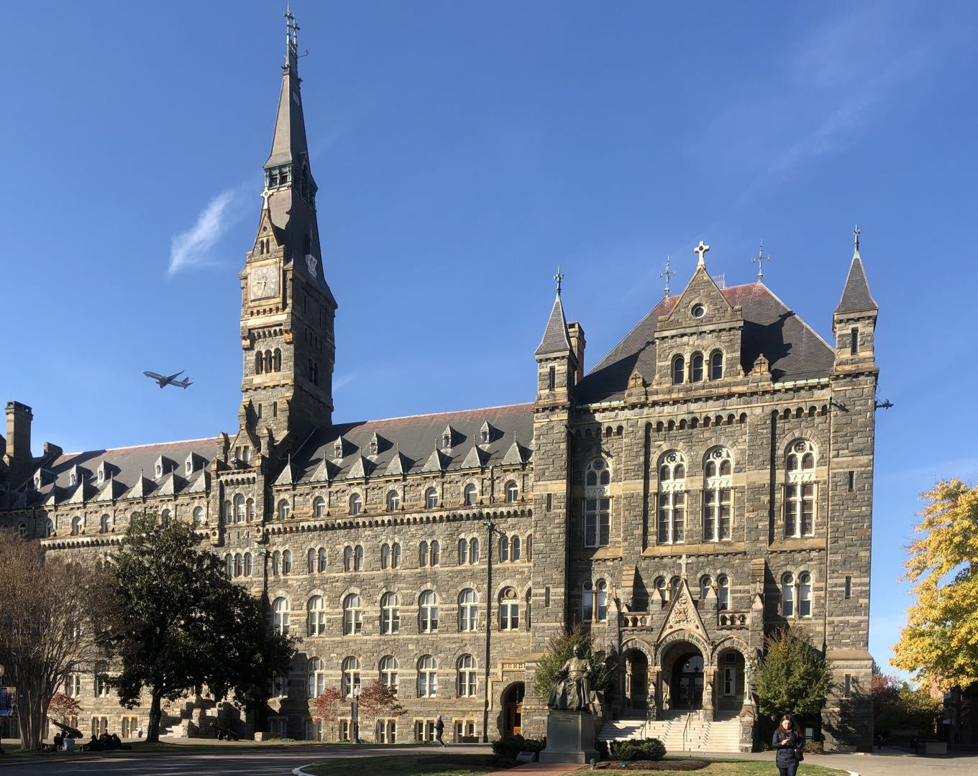
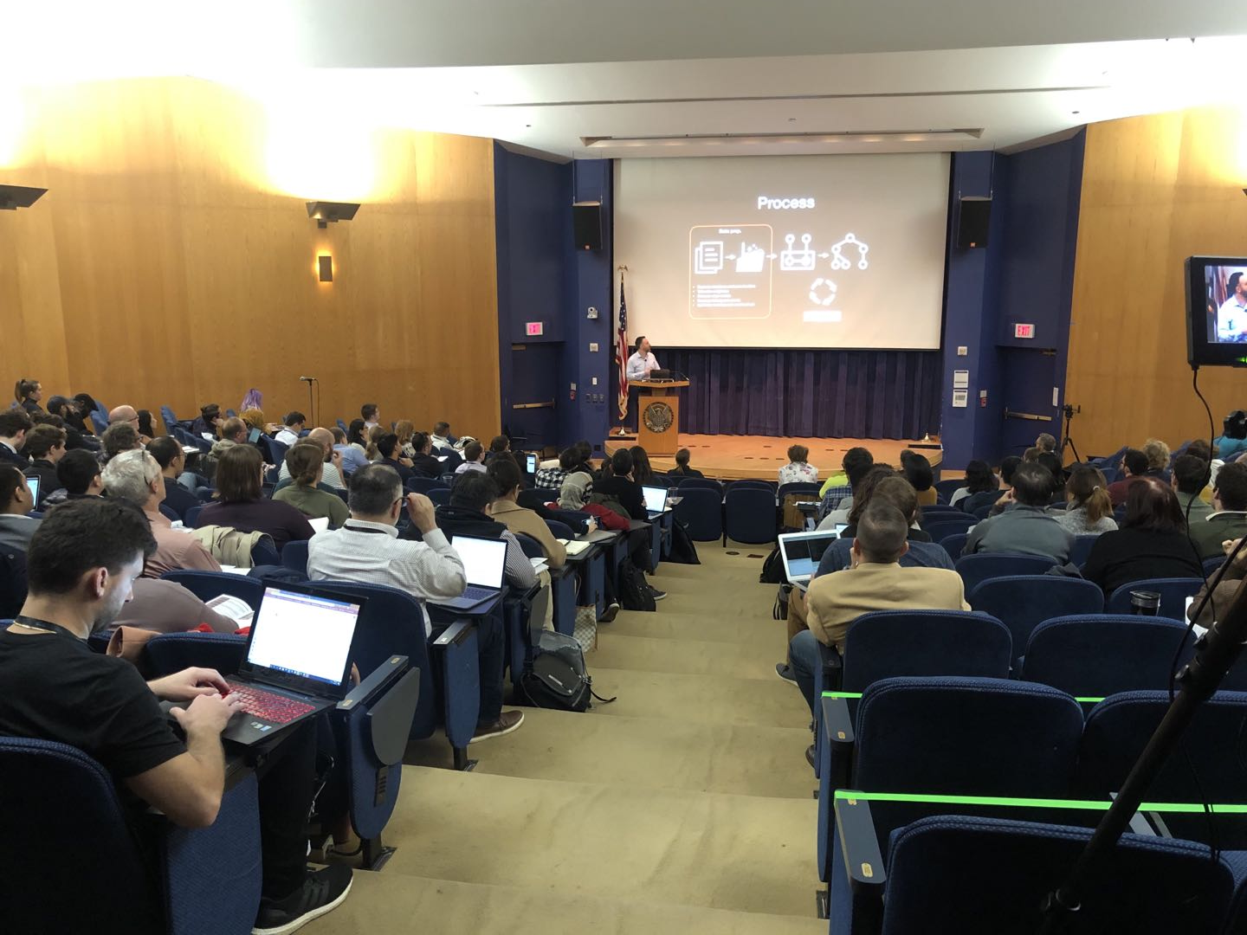
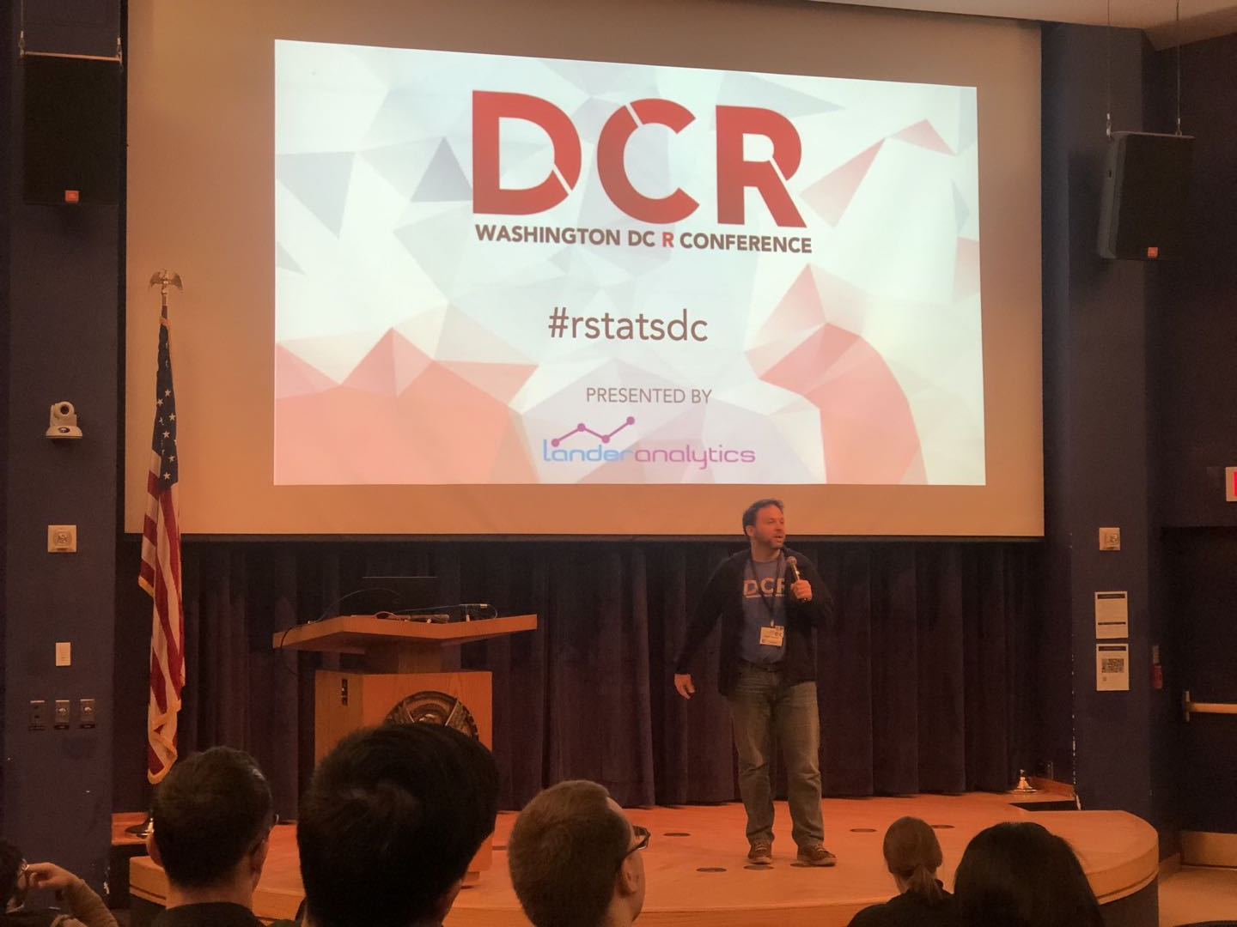
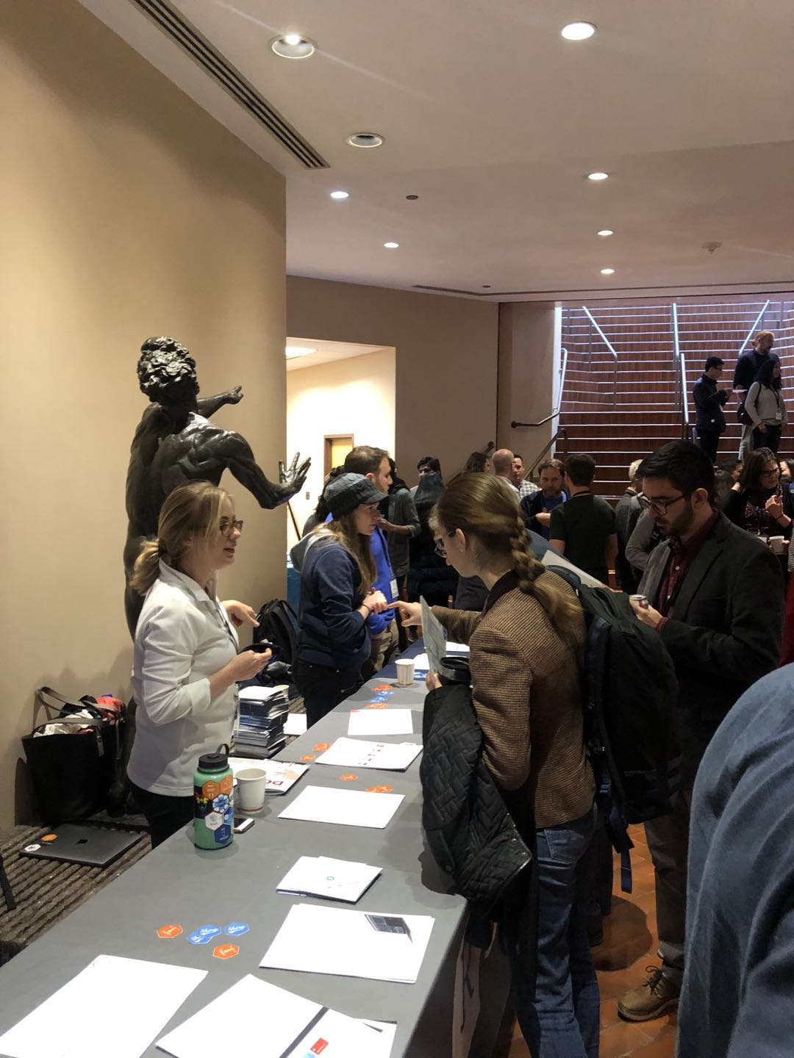


Slide 3

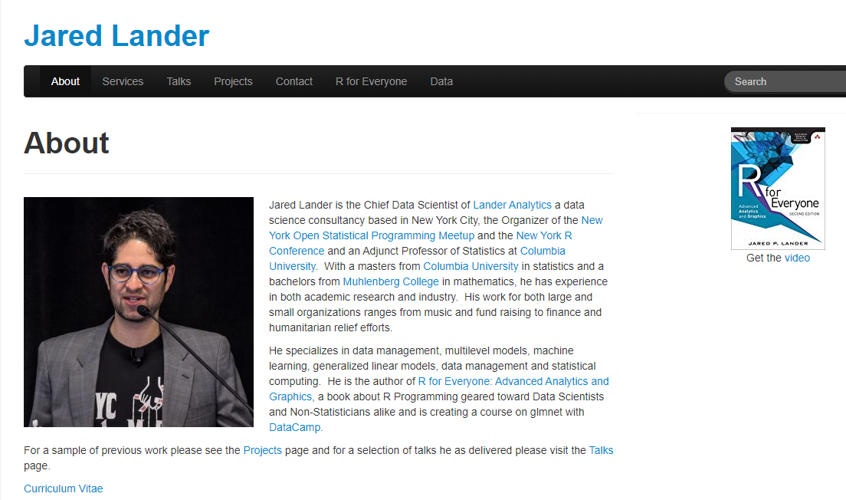

Slide 4
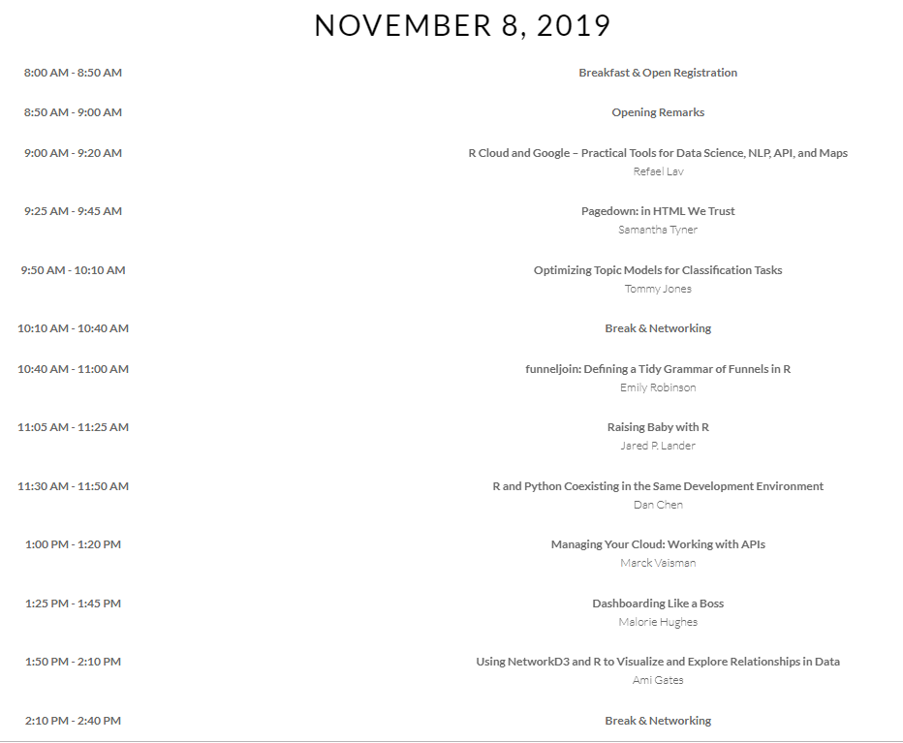
25 Speakers 3-day Agenda Talk Videos

Slide 5
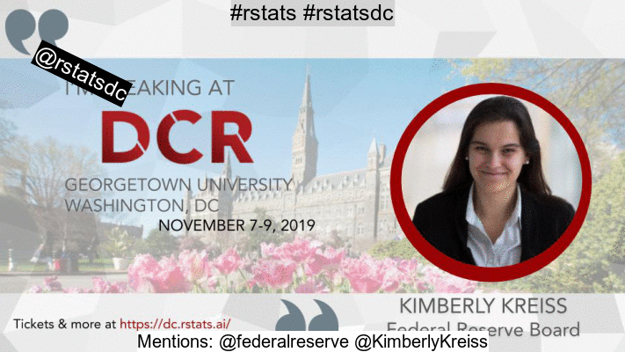
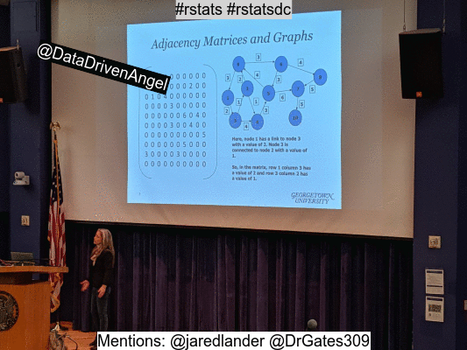

Slide 6
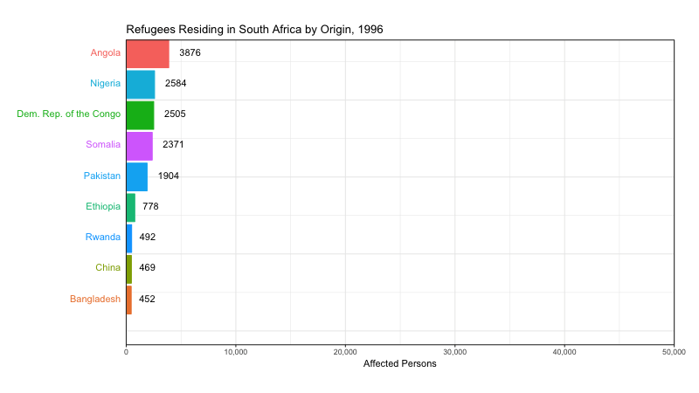
Animation for Dataviz in R
Stephanie Kirmer (https://github.com/skirmer)

Slide 7
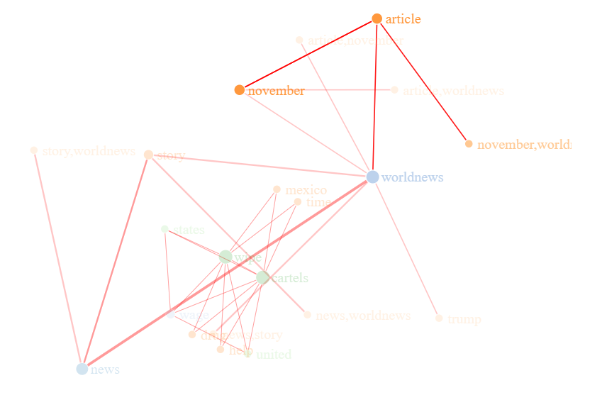
Using NetworkD3 and R to Visualize and Explore Relationships in Data Ami Gates (http://drgates.georgetown.domains/#home)

Slide 8
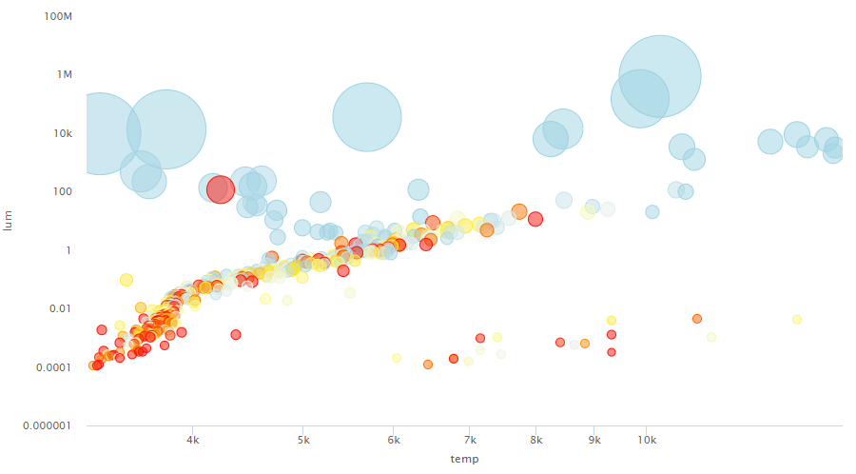
Dashboard Like a Boss Malorie Hudges (https://github.com/maloriejhughes)
printr; stargazer; summarytools; DT; Highcharter

Slide 9
Optimizing Topic Models for Classification Tasks Tommy Jones (https://www.youtube.com/watch?v=k6kCSzWigiI)
RBERT: Cutting Edge NLP in R Jon Harmon (https://www.youtube.com/watch?v=1kV0fPDefBM)

